Slide 1
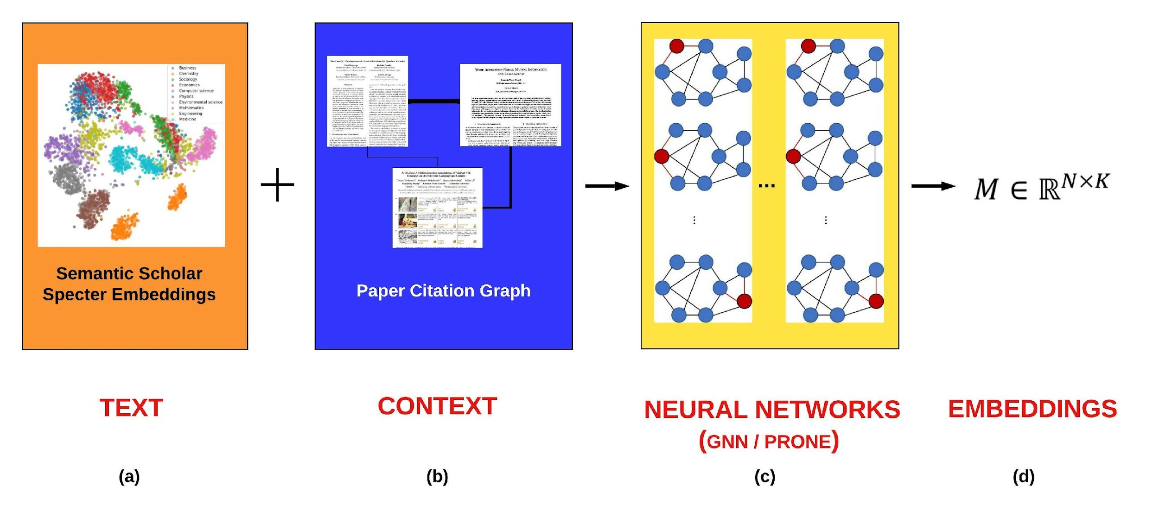
Better Together

Slide 2
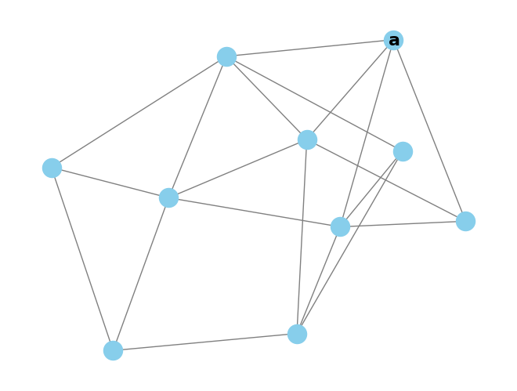
Intrinsic Evaluation - Random Walk Classification
Randomly pick start paper a

Slide 3
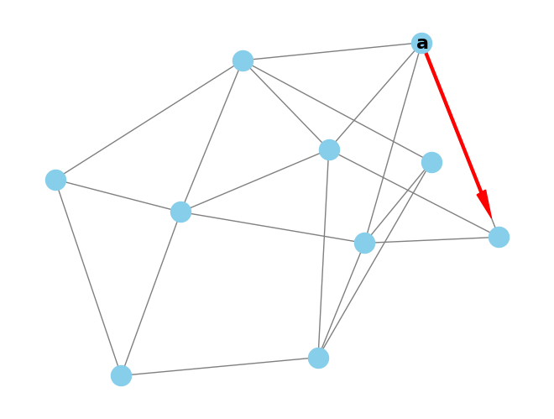
Intrinsic Evaluation - Random Walk Classification
Randomly pick start paper a
Jump to any referenced or citing paper

Slide 4
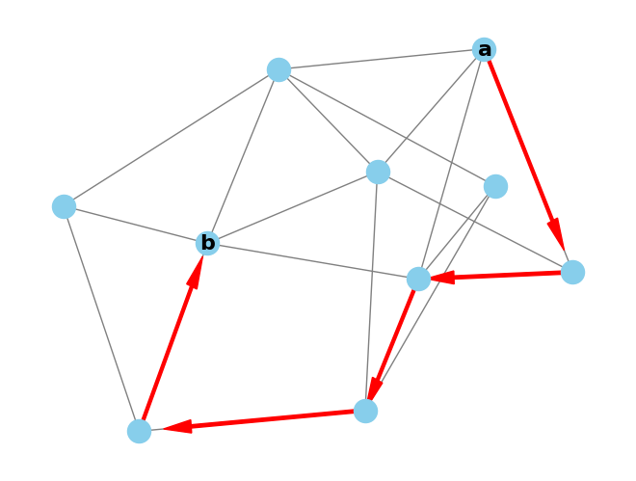
Intrinsic Evaluation - Random Walk Classification
Randomly pick start paper a
Jump to any referenced or citing paper
Repeat to reach final paper b

Slide 5
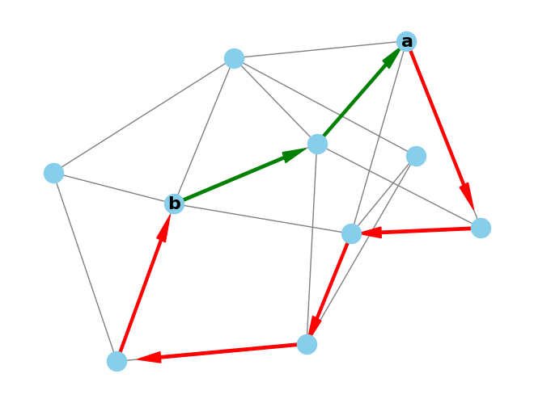
Intrinsic Evaluation - Random Walk Classification
Randomly pick start paper a
Jump to any referenced or citing paper
Repeat to reach final paper b
Verify the shortest path between a and b is in [1,4]
= 2-hop

Slide 6
Intrinsic Evaluation - Random Walk Classification
Randomly pick start paper a
Jump to any referenced or citing paper
Repeat to reach final paper b
Verify the shortest path between a and b is in [1,4]
It’s cheap to collect these of random walks, we have 3M
Hypothesis: representation models should have higher similarity for 1 hop than 2-4 hops.

Slide 7
Intrinsic Evaluation - Random Walk Forecasting
Can assign walks to bins for forecast evaluation
Walk bin = max(bin(a), bin(b))
Given the ProNE trained models, how well can they:
Remember from train (bin<=train split)
Predict the future (bin>train split)
Does this get harder as bin >> train split?

Slide 8
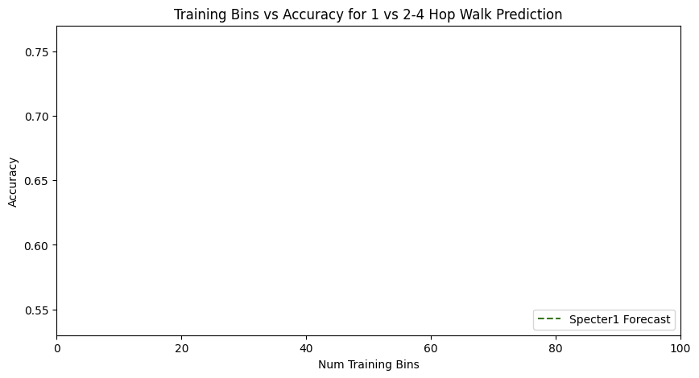
Forecasting with Text

Slide 9
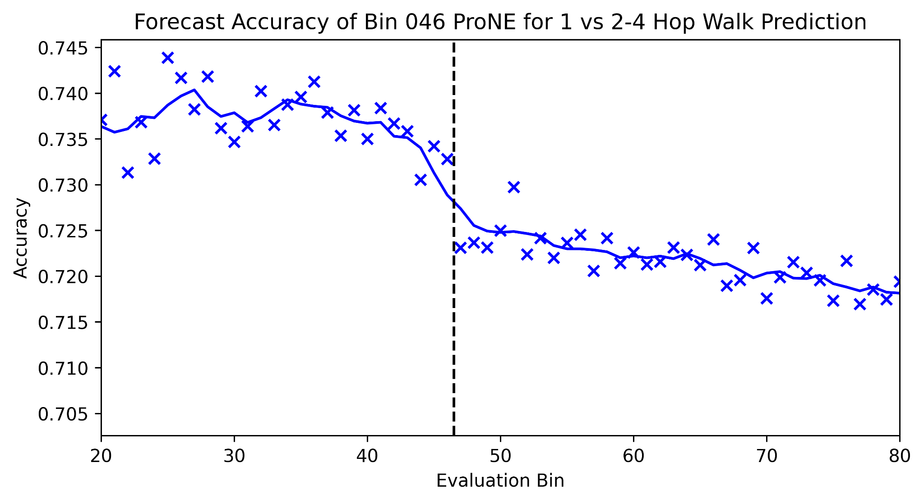
Forecasting from Bin 46

Slide 10
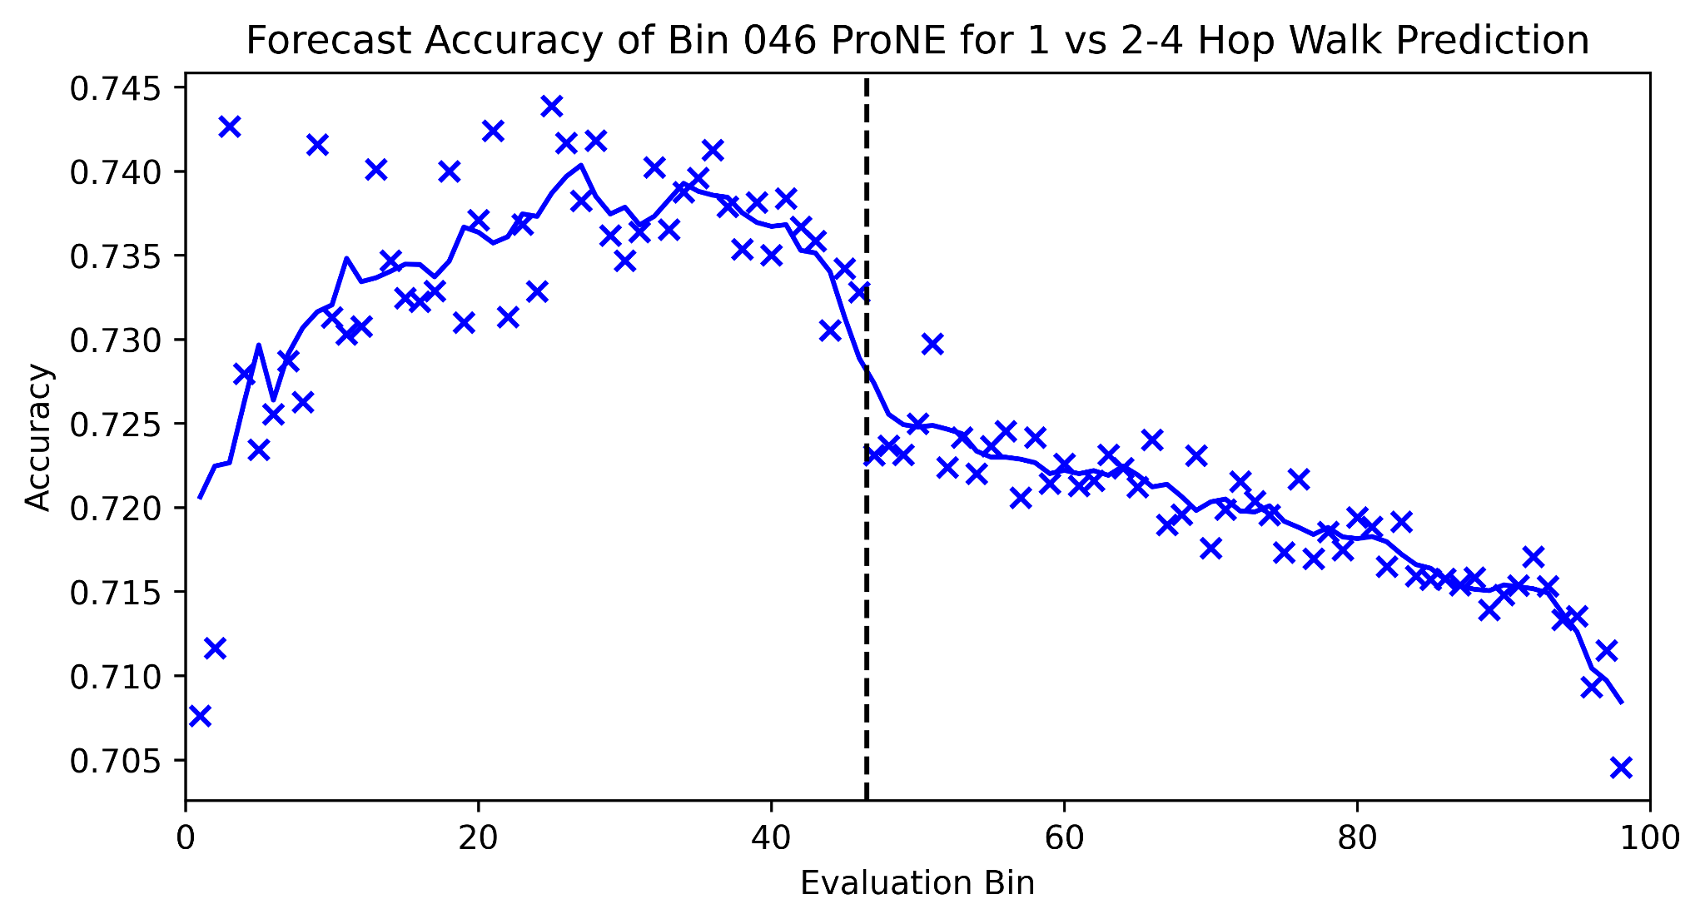
Forecasting from Bin 46 - Full Picture

Slide 11
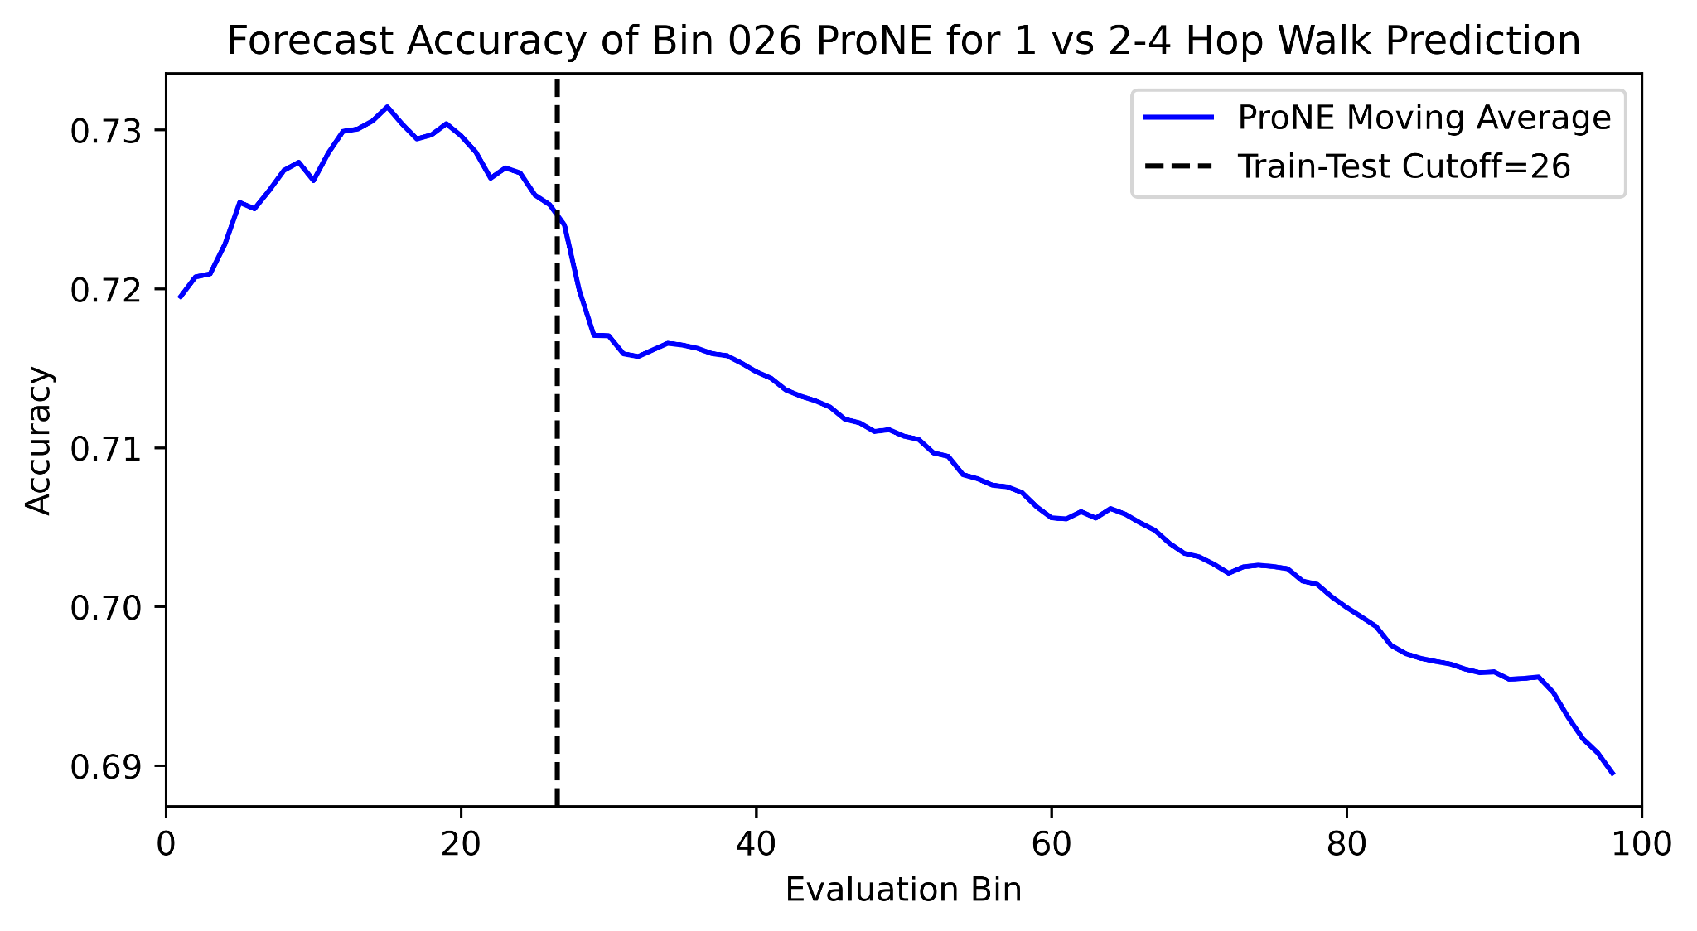
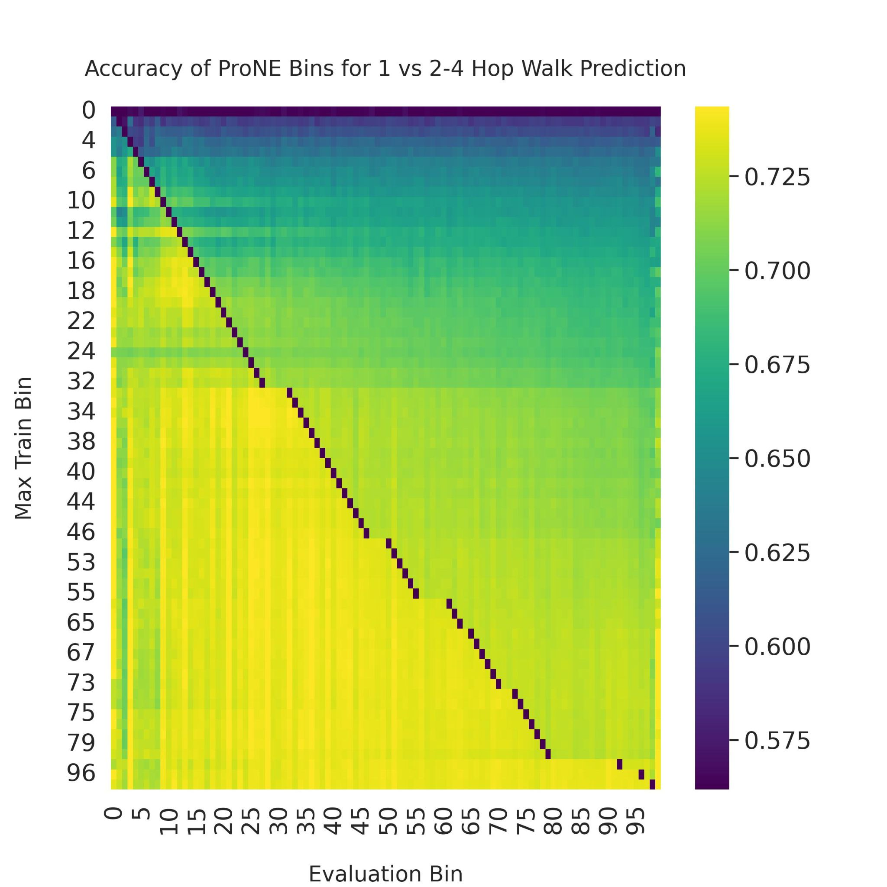
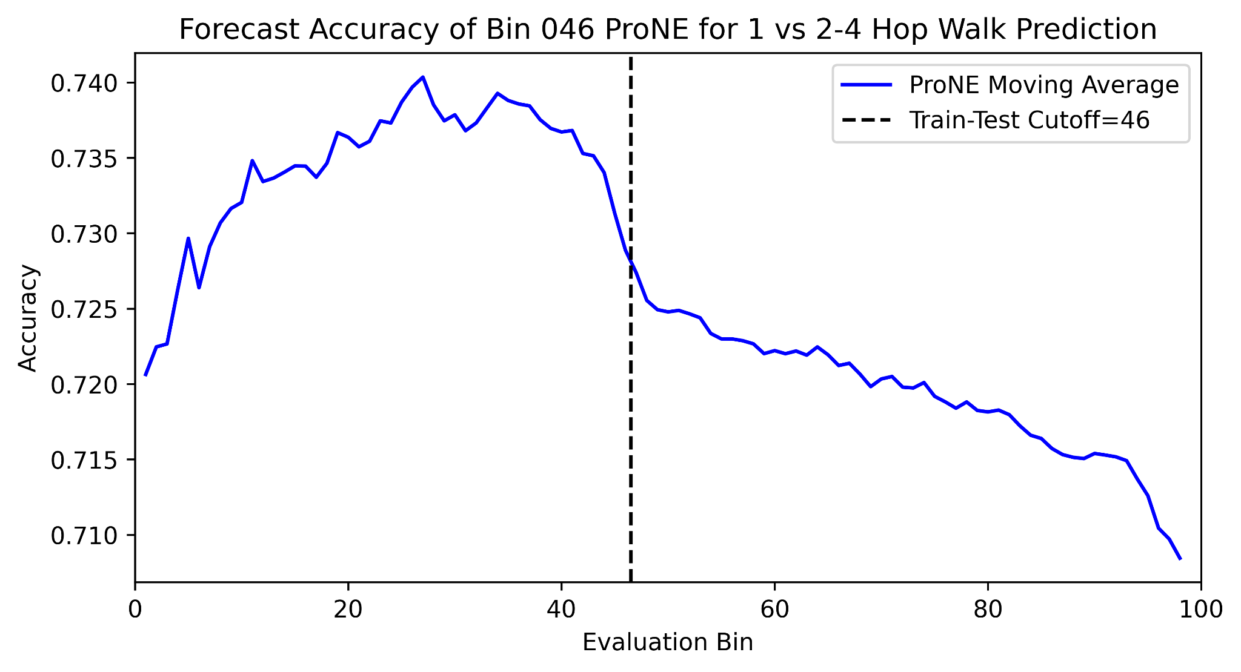
Forecasting for all Train-Test Splits
Forecasting Further
Hard
Easy

Slide 12
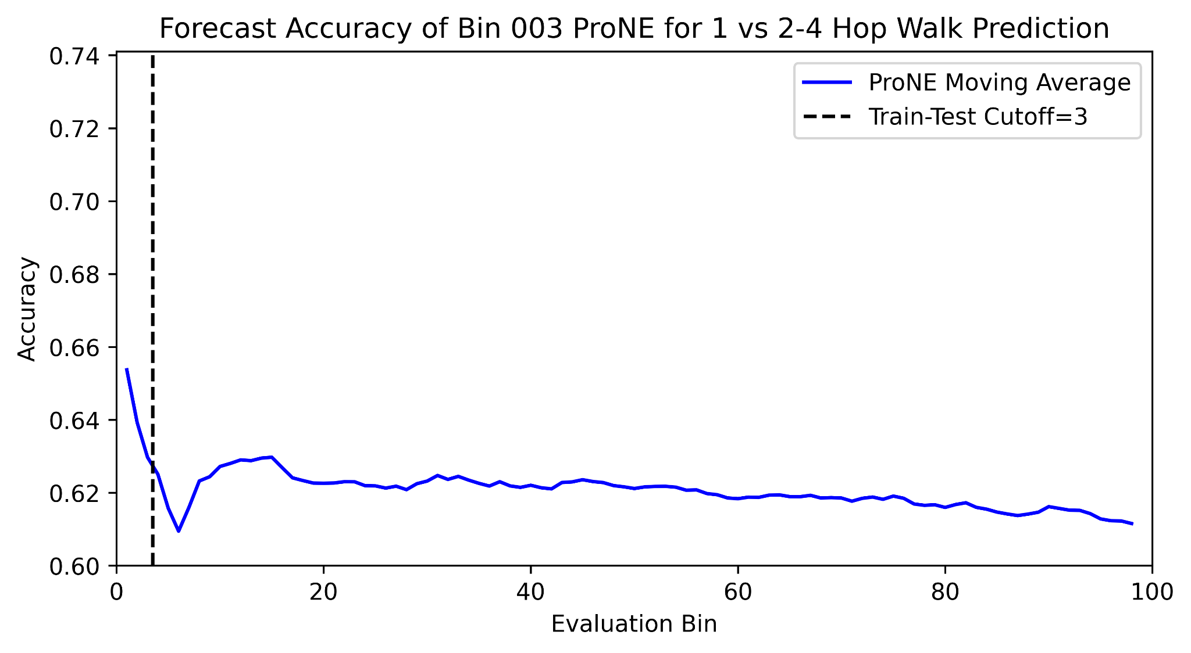
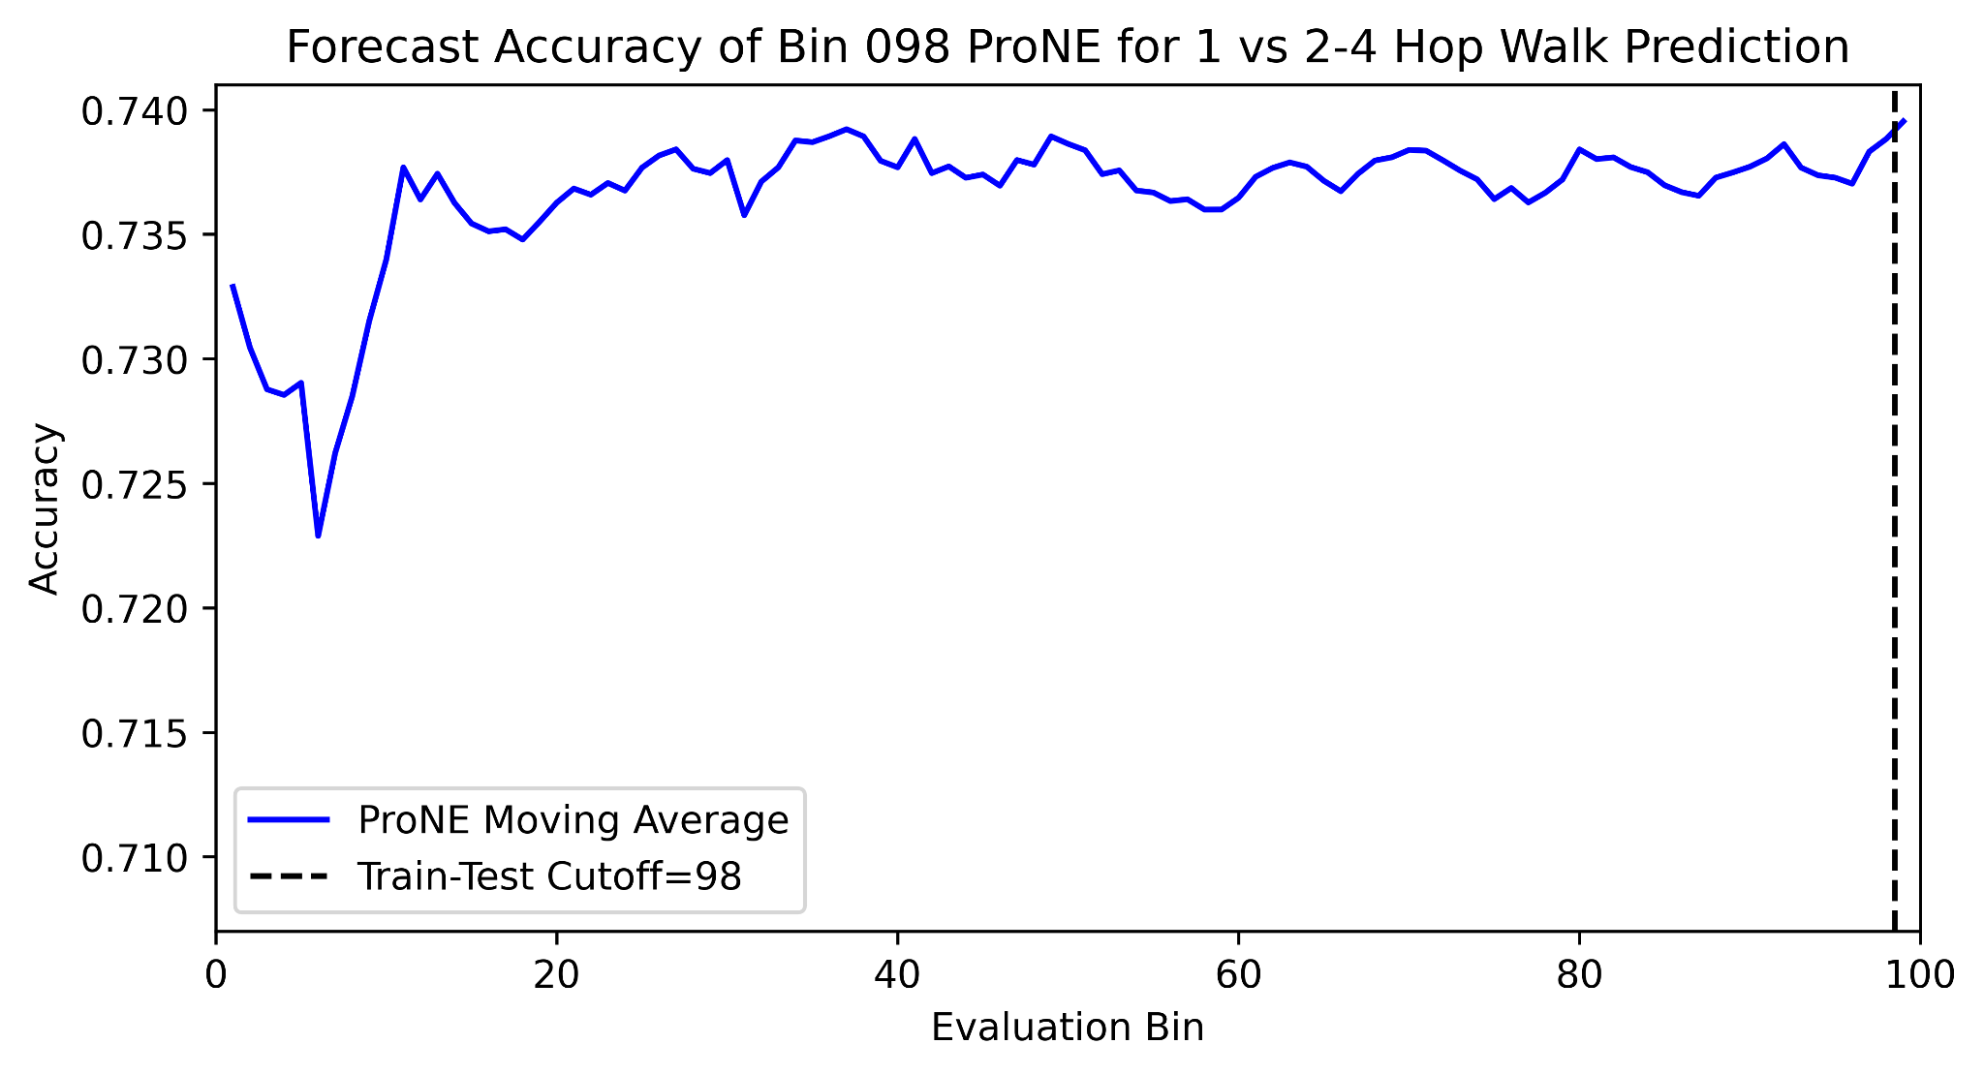
Forecasting for all Train-Test Splits - Extremes
Hard
Easy

Slide 13
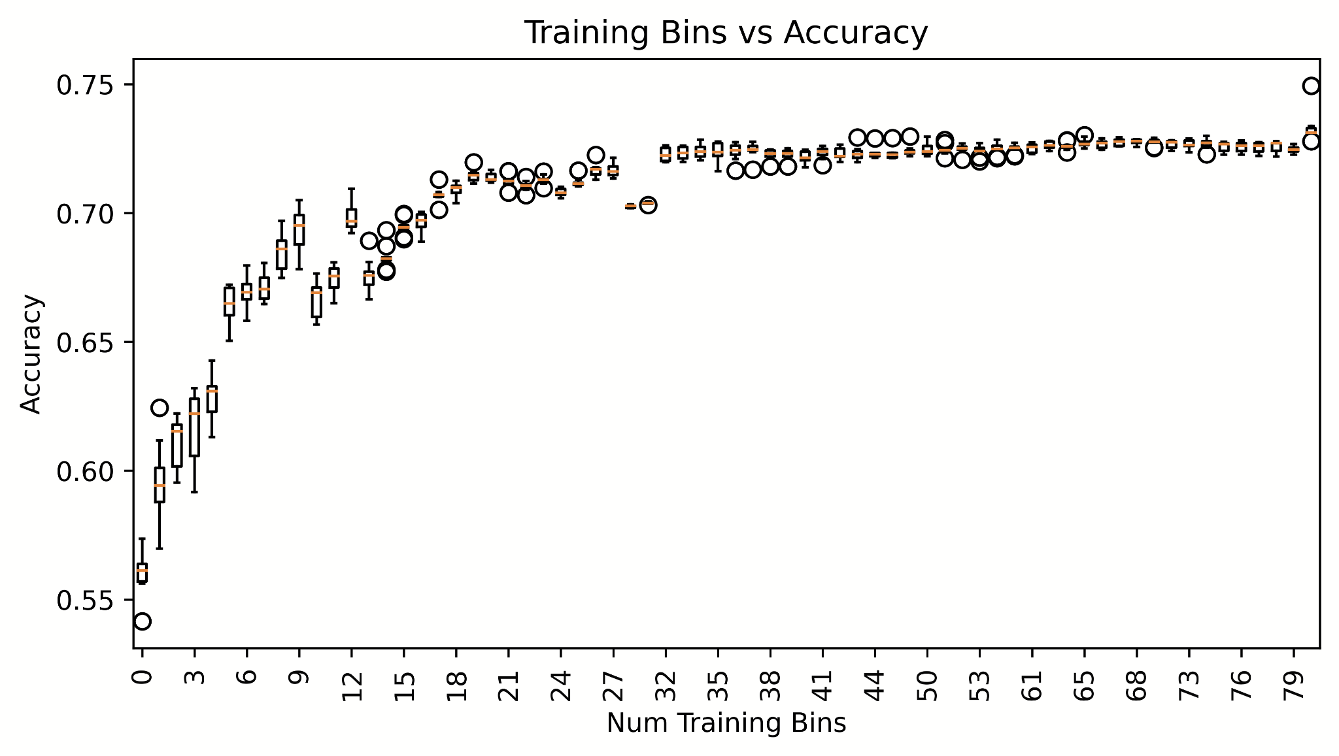
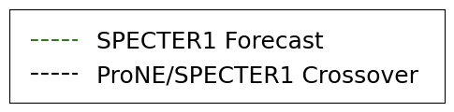
Training Size vs Forecast Ability

Slide 14
Training Size vs Forecast Ability
Context > Text: Metcalfe’s Law!

Slide 15
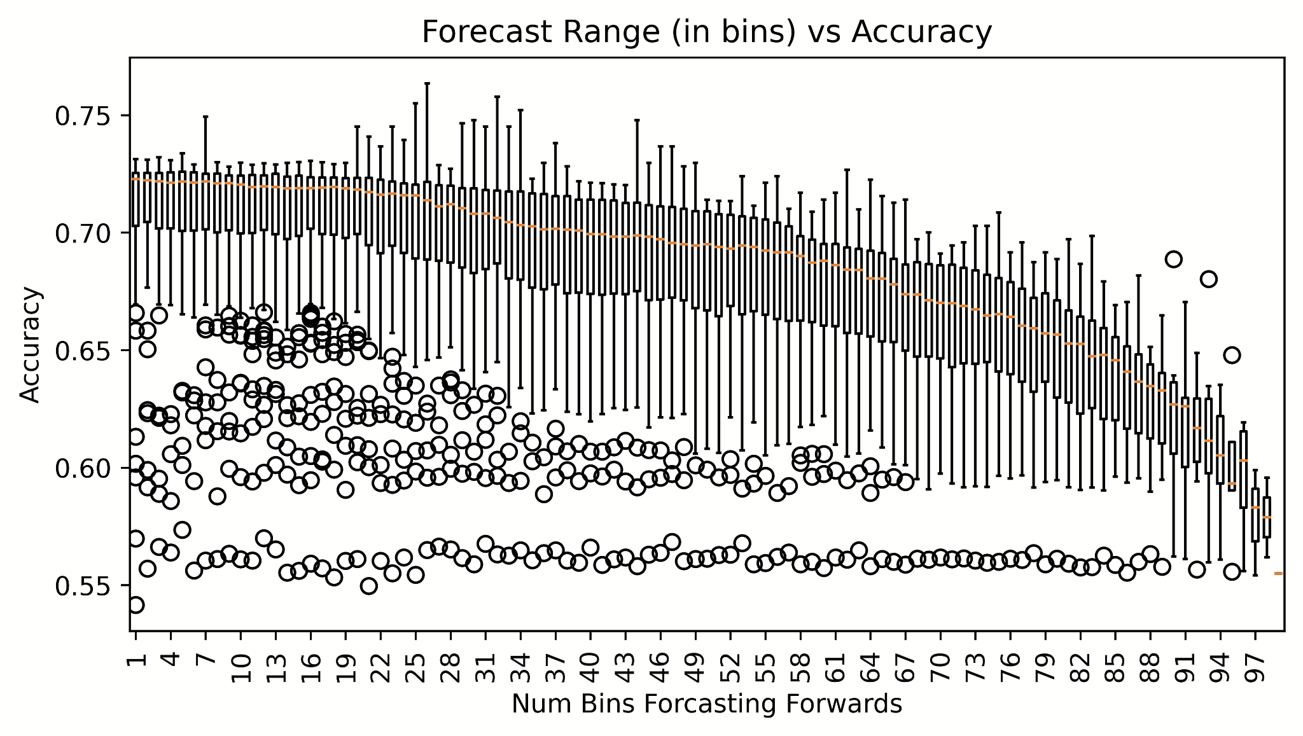
Forecast Distance vs Accuracy
Short-range Forecasting
Long-range Forecasting

Slide 16
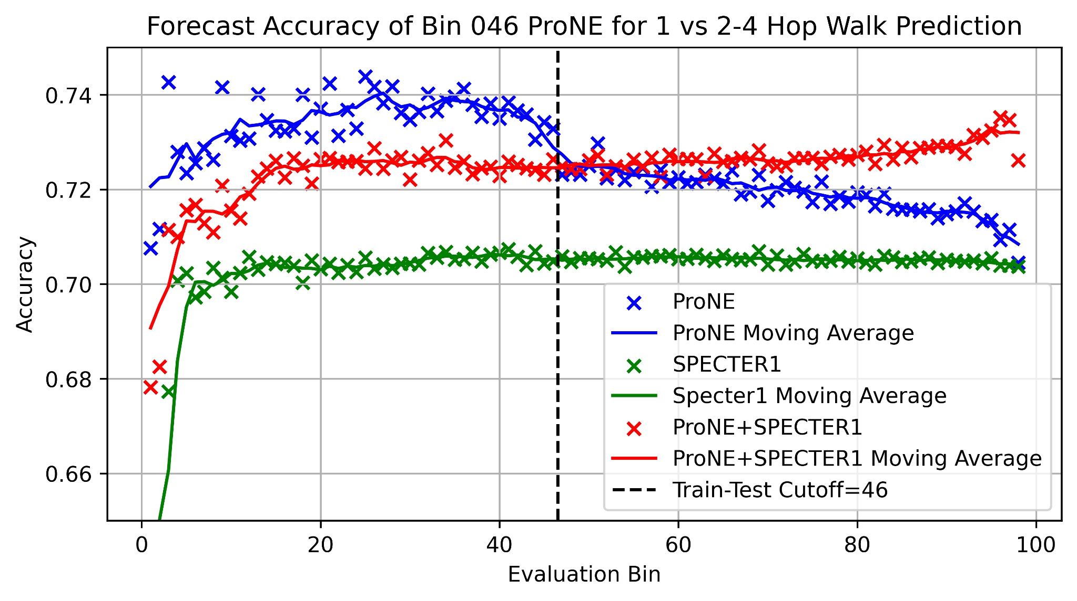
Text, Context, and Better Together

Slide 17
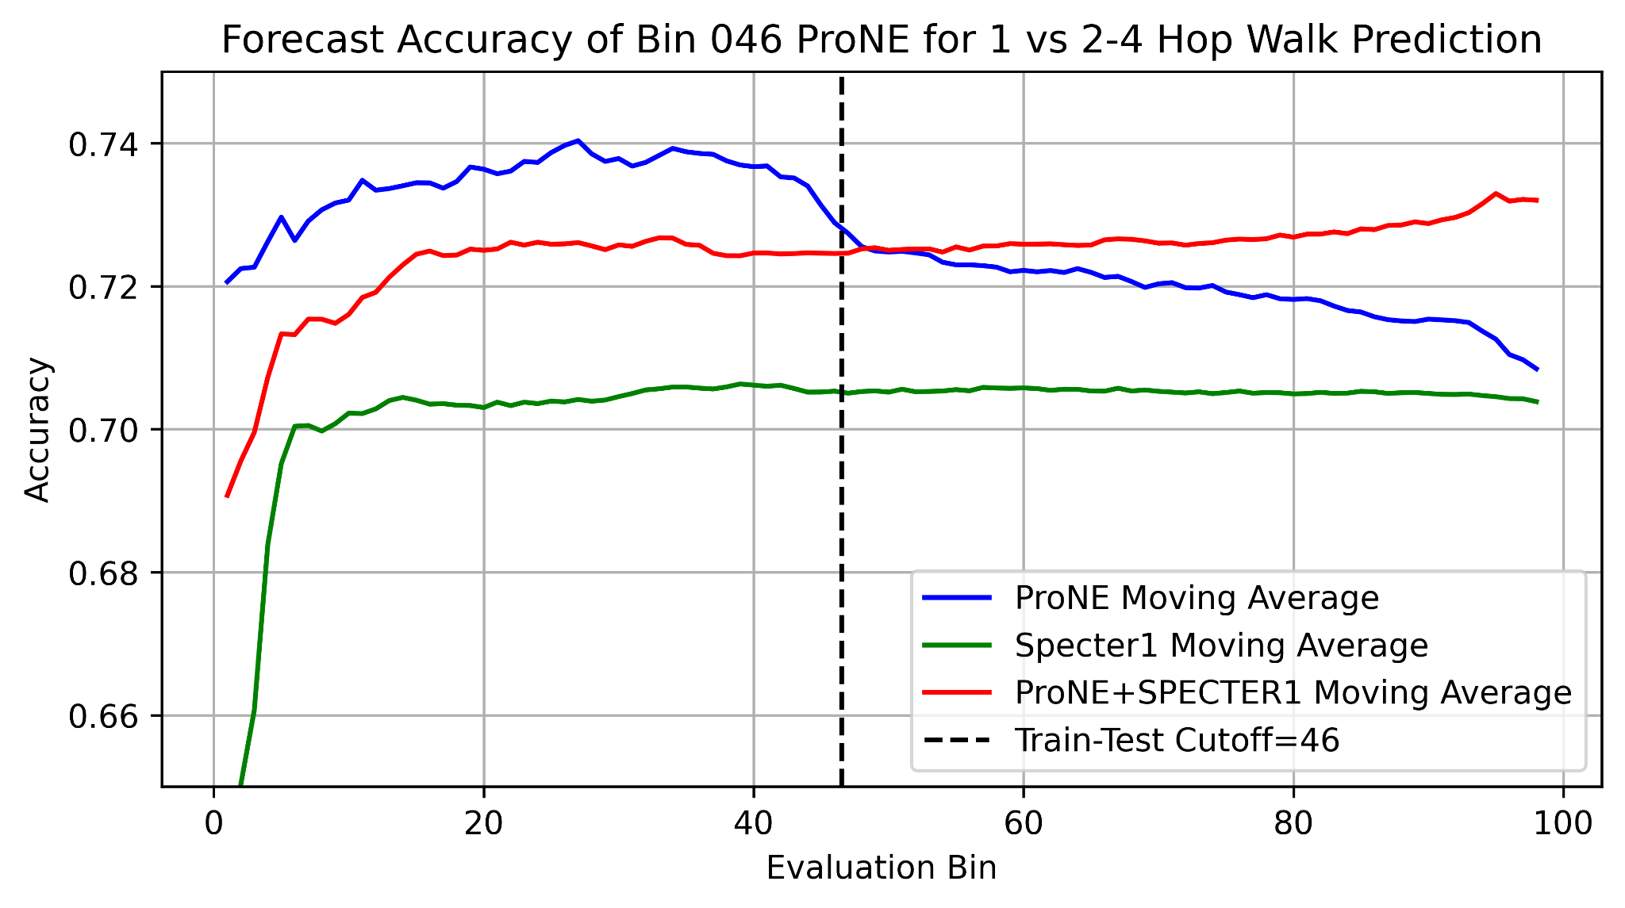
Text, Context, and Better Together

Slide 18
Intrinsic Evaluation - Random Walk Classification
Conclusions:
Context works: ProNE model is effective for modelling document links

Slide 19
Intrinsic Evaluation - Random Walk Classification
Conclusions:
Context works: ProNE model is effective for modelling document links
A large (50M+) train collection is required to get the best out of ProNE
Working with scale is required (Metcalfe's Law)
At lower scales, text is better

Slide 20
Intrinsic Evaluation - Random Walk Classification
Conclusions:
Context works: ProNE model is effective for modelling document links
A large (50M+) train collection is required to get the best out of ProNE
Working with scale is required (Metcalfe's Law)
At lower scales, text is better
Forecasting gets harder as we move out from the training set
Models are always rotting, incremental updates are needed

Slide 21
Intrinsic Evaluation - Random Walk Classification
Conclusions:
Context works: ProNE model is effective for modelling document links
A large (50M+) train collection is required to get the best out of ProNE
Working with scale is required (Metcalfe's Law)
At lower scales, text is better
Forecasting gets harder as we move out from the training set
Models are always rotting, incremental updates are needed
Text is a baseline, can use as a fallback to further improve performance
Text+Context: Better Together!

Slide 22
Extrinsic Evaluation – Local Citation Recommendation
Citation Recommendation = ‘What should I cite?’
Local Citation Recommendation = ‘What should I cite here in the document?’
Established task, many datasets (FullTextPeerRead 10K - RefSeer 3M samples)
We create our own task from full text Semantic Scholar Data (S2ORC)
Every citing sentence (400M) is a data point (400M samples)
Any Full-text paper in S2ORC (12M) is a valid source
Any paper is Semantic Scholar (200M) is a valid target

Slide 23
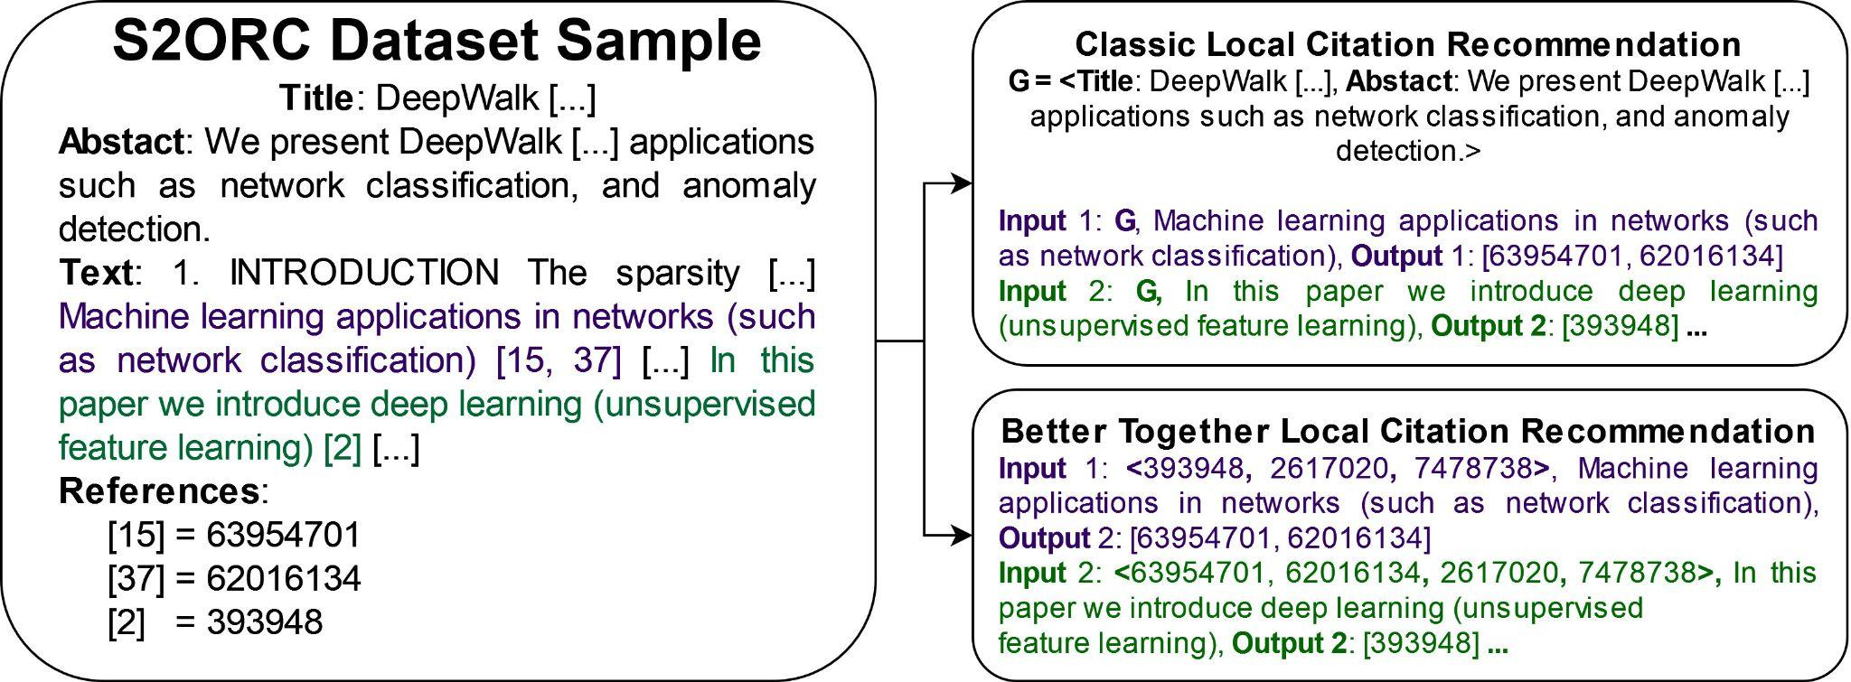
Local Citation Recommendation Format
Notes:
Refer to original paper before this. Link prediction refers to many things – earlier was one of simpler ones, whether i cites j. Introducing more complex problem
Reduce text
? answer, not q
use animations?
Emphasize task as predicting citations associated with citing sentence

Slide 24
Local Citation Recommendation Methods
Text-based Search
Citing Sentences
Embeddings of the citing sentence -> citing sentences, return their target id
Title+Citing Sentence
Embeddings of the title+citing sentence -> other titles and abstracts, return their id
Title+Abstract
Embeddings of the title+abstract -> other titles and abstracts, return their id
Citing Sentences
Author: Alan Turing
Title: “On Computable Numbers”
Abstract: “The 'computable' numbers may be described briefly as [...]”
Often cited as ‘Turing Machine [paper]’ - but Turing never used those words

Slide 25
Local Citation Recommendation Methods
Reference-based Search
Source
ProNE embeddings of the source document -> ProNE embeddings of the target document
‘Centroid Method’
Average of ProNE embeddings of other references -> ProNE embeddings of the target document
Weighted ‘Centroid Method’
Distance-weighted average of ProNE embeddings of other references -> ProNE embeddings of the target document

Slide 26
Local Citation Recommendation Methods
Text-based Search
Citing Sentences
Embeddings of the citing sentence -> citing sentences, return their target id
Title+Citing Sentence
Embeddings of the title+citing sentence -> other titles and abstracts, return their id
Title+Abstract
Embeddings of the title+abstract -> other titles and abstracts, return their id
Reference-based Search
Source
ProNE embeddings of the source document -> ProNE embeddings of the target document
‘Centroid Method’
Average of ProNE embeddings of other references -> ProNE embeddings of the target document
Weighted ‘Centroid Method’
Distance-weighted average of ProNE embeddings of other references -> ProNE embeddings of the target document

Slide 27
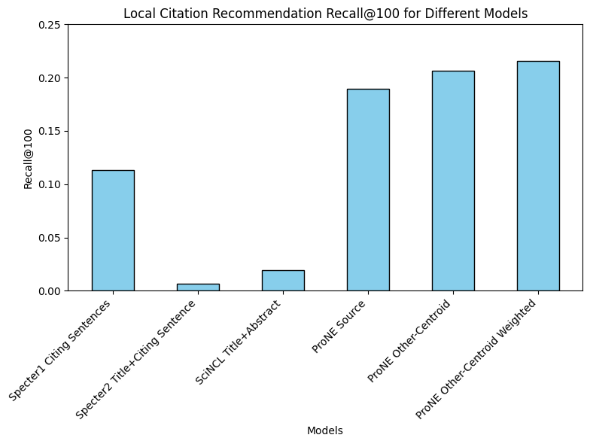
Local Citation Recommendations - Text vs Context R@100
Model | R@100
Specter1 Citing Sentences | 0.1133
Specter2 Title+Citing Sentence | 0.0067
SciNCL Title+Abstract | 0.0194
ProNE Source | 0.1898
ProNE Other-Centroid | 0.2068
ProNE Other-Centroid Weighted | 0.2156

Slide 28
Local Citation Recommendations - Text vs Context R@100
Model | R@100
Specter1 Citing Sentences | 0.1133
Specter2 Title+Citing Sentence | 0.0067
SciNCL Title+Abstract | 0.0194
ProNE Source | 0.1898
ProNE Other-Centroid | 0.2068
ProNE Other-Centroid Weighted | 0.2156

Slide 29
Local Citation Recommendations - Text vs Context R@100
Model | R@100
Specter1 Citing Sentences | 0.1133
Specter2 Title+Citing Sentence | 0.0067
SciNCL Title+Abstract | 0.0194
ProNE Source | 0.1898
ProNE Other-Centroid | 0.2068
ProNE Other-Centroid Weighted | 0.2156

Slide 30
Local Citation Recommendations - Text vs Context R@100
Model | R@100
Specter1 Citing Sentences | 0.1133
Specter2 Title+Citing Sentence | 0.0067
SciNCL Title+Abstract | 0.0194
ProNE Source | 0.1898
ProNE Other-Centroid | 0.2068
ProNE Other-Centroid Weighted | 0.2156

Slide 31
Local Citation Recommendations - Text vs Context R@100
Model | R@100
Specter1 Citing Sentences | 0.1133
Specter2 Title+Citing Sentence | 0.0067
SciNCL Title+Abstract | 0.0194
ProNE Source | 0.1898
ProNE Other-Centroid | 0.2068
ProNE Other-Centroid Weighted | 0.2156

Slide 32
Local Citation Recommendations - Text vs Context R@100
Model | R@100
Specter1 Citing Sentences | 0.1133
Specter2 Title+Citing Sentence | 0.0067
SciNCL Title+Abstract | 0.0194
ProNE Source | 0.1898
ProNE Other-Centroid | 0.2068
ProNE Other-Centroid Weighted | 0.2156

Slide 33
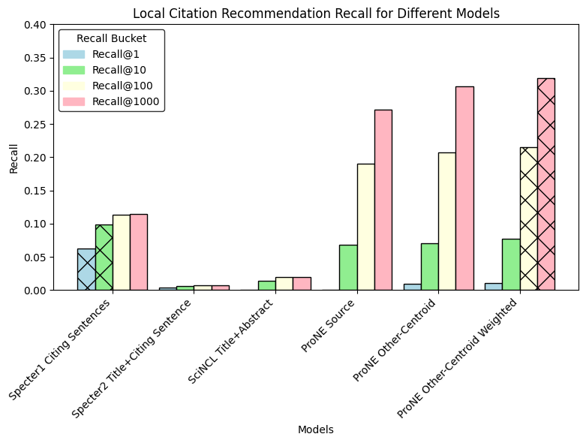
Local Citation Recommendations - Text Vs Context
Model | R@1 | R@10 | R@100 | R@1000
Specter1 Citing Sentences | 0.0622 | 0.0988 | 0.1133 | 0.1141
Specter2 Title+Citing Sentence | 0.0033 | 0.0059 | 0.0067 | 0.0067
SciNCL Title+Abstract | 0.0004 | 0.0143 | 0.0194 | 0.0194
ProNE Source | 0.0005 | 0.0684 | 0.1898 | 0.2717
ProNE Other-Centroid | 0.0093 | 0.0705 | 0.2068 | 0.3068
ProNE Other-Centroid Weighted | 0.0100 | 0.0771 | 0.2156 | 0.3195

Slide 34
Local Citation Recommendations - Text Vs Context
Model | R@1 | R@10 | R@100 | R@1000
Specter1 Citing Sentences | 0.0622 | 0.0988 | 0.1133 | 0.1141
Specter2 Title+Citing Sentence | 0.0033 | 0.0059 | 0.0067 | 0.0067
SciNCL Title+Abstract | 0.0004 | 0.0143 | 0.0194 | 0.0194
ProNE Source | 0.0005 | 0.0684 | 0.1898 | 0.2717
ProNE Other-Centroid | 0.0093 | 0.0705 | 0.2068 | 0.3068
ProNE Other-Centroid Weighted | 0.0100 | 0.0771 | 0.2156 | 0.3195

Slide 35
Local Citation Recommendations - Conclusions
Reference Recommendation at the 200M paper scale is possible but hard

Slide 36
Local Citation Recommendations - Conclusions
Reference Recommendation at the 200M paper scale is possible but hard
Citing sentences are a great signal - but incomplete
We get the information quickly (@10, then nothing more)
Recall@10 0.099, Recall@100 0.113 (+0.014)

Slide 37
Local Citation Recommendations - Conclusions
Reference Recommendation at the 200M paper scale is possible but hard
Citing sentences are a great signal - but incomplete
We get the information quickly (@10, then nothing more)
Recall@10 0.099, Recall@100 0.113 (+0.014)
As the intrinsic evaluation found, ProNE is very capable at link prediction
Gain less strong initially but continues down the retrieval list (@100, @1000)
Local weighting adds around 0.01
R@10 0.077, R@100 0.216 (+0.139) R@1000 0.320 (+0.104)

Slide 38
Local Citation Recommendations - Conclusions
Reference Recommendation at the 200M paper scale is possible but hard
Citing sentences are a great signal - but incomplete
We get the information quickly (@10, then nothing more)
Recall@10 0.099, Recall@100 0.113 (+0.014)
As the intrinsic evaluation found, ProNE is very capable at link prediction
Gain less strong initially but continues down the retrieval list (@100, @1000)
Local weighting adds around 0.01
R@10 0.077, R@100 0.216 (+0.139) R@1000 0.320 (+0.104)
Title+Abstracts alone are pretty weak
Future work: combine citing sentence and ProNE systems for recommendation

